Slide 1
Special effects
In this session, we will explore special effects.
Special effects are a key component of modern image processing, adding creativity and uniqueness to images.
Special effects refer to various techniques used to manipulate images in ways that go beyond traditional enhancement.
We may want to do this for effect alone, or simply for fun. There are a great many different effects possible, and in this chapter we shall look at a few of them

Slide 2
1. Radial pixilation
2. Ripple Effects
3.General Distortion Effects(Fisheye and twirls, Jitter and circular slice, The fuzzy effect, Jitter and circular slice, The fuzzy effect )
4.Pixel Effects(The oil painting effect, solarization effect)

Slide 3
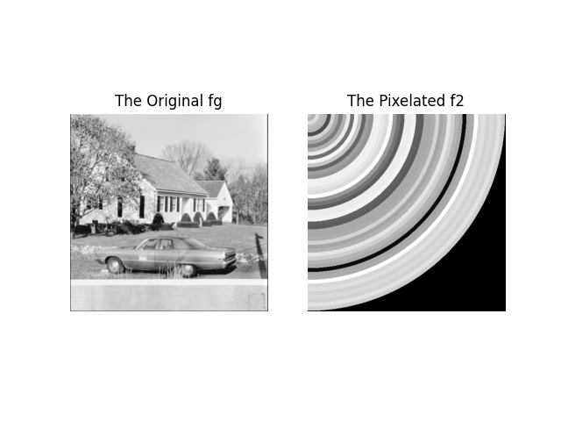
Radial pixelation
Python code:
f = io.imread('D://Dataset//house.tiff')
fg = color.rgb2gray(f)
ox = oy = 0
rows, cols = fg.shape
y, x = np.indices((rows, cols))
r = np.sqrt((x - ox)**2 + (y - oy)**2)
step = 10
x2 = (r // step) * step + step // 2
y2 = x2
x2 = np.clip(x2, 0, cols - 1).astype(int)
y2 = np.clip(y2, 0, rows - 1).astype(int)
f2 = fg[y2, x2]
Fig: Radial pixelation

Slide 4
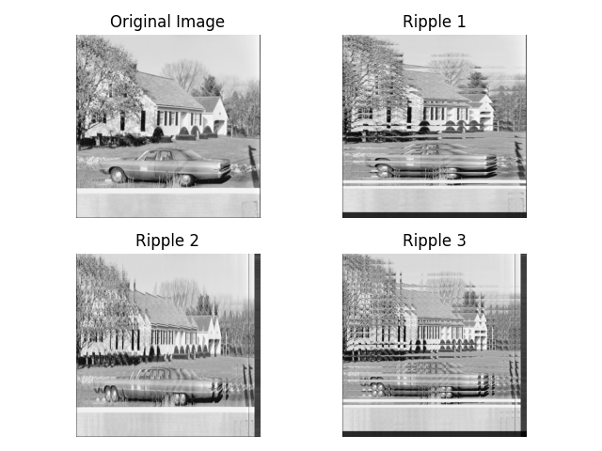
Ripple Effects
Python code:
f = io.imread('D://Dataset//house.tiff')
fg = color.rgb2gray(f)
y, x = np.indices((cols, rows))
x2 = clip(x + x % 32, 0, rows - 1)
ripple1 = np.reshape(fg[x2.ravel(), y.ravel()], (cols, rows)).T
y2 = clip(y + y % 32, 0, cols - 1)
ripple2 = np.reshape(fg[x.ravel(), y2.ravel()], (rows, cols)).T
y3 = clip(y + y % 32, 0, cols - 1)
ripple3 = np.reshape(fg[x2.ravel(), y3.ravel()], (cols, rows)).T
Fig: Ripple Effects

Slide 5
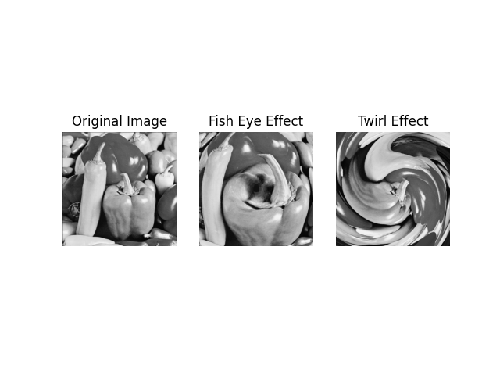
General Distortion Effects Fisheye and twirls
Python code:
#FishEye
r,theta,ox,oy = polarmesh(fg)
s=r**2/r.max()
f2=polar2im(s,theta,fg)
#Twirl
K=100
phi=theta+(r/K)
twirl=polar2im(r,phi,fg)
Fig: Fisheye and twirls effects

Slide 6
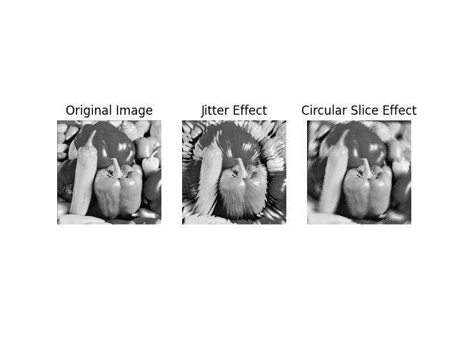
General Distortion Effects Jitter and circular slice
Python code:
#Jitter Effect
phi=theta+(theta%(8*np.pi/180))-4*np.pi/180
jitter=polar2im(r,phi,fg)
#Circular Slice
phi=theta+((r%6)*(np.pi/180))
circularSlice=polar2im(r,phi,fg)
Fig: Jitter and circular slice effects

Slide 7
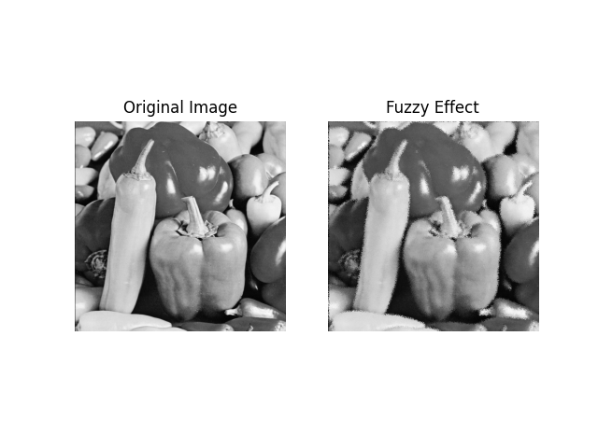
General Distortion Effects The fuzzy effect
Python code:
#Fuzzy Effect
x2=x+np.random.randint(-3,3,size=(rows,cols))
y2=y+np.random.randint(-3,3,size=(rows,cols))
x2=clip(x2,0,rows-1).astype(int)
y2=clip(y2,0,cols-1).astype(int)
f2=np.reshape(fg[x2.ravel(),y2.ravel()],(rows,cols)).T
Fig: The fuzzy effect

Slide 8
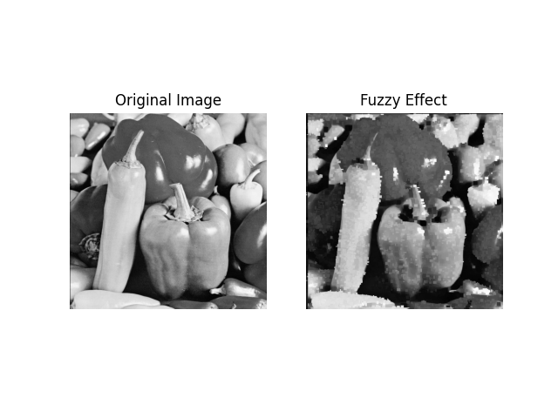
Pixel Effects The oil painting effect
Python code:
#oil paint effect
def mymode(x):
return stats.mode(x, axis=None, keepdims=True)[0][0]
f2 = ndi.generic_filter(fg, mymode, size=(9, 9))
Fig: The oil painting effect with different filter size 9x9

Slide 9
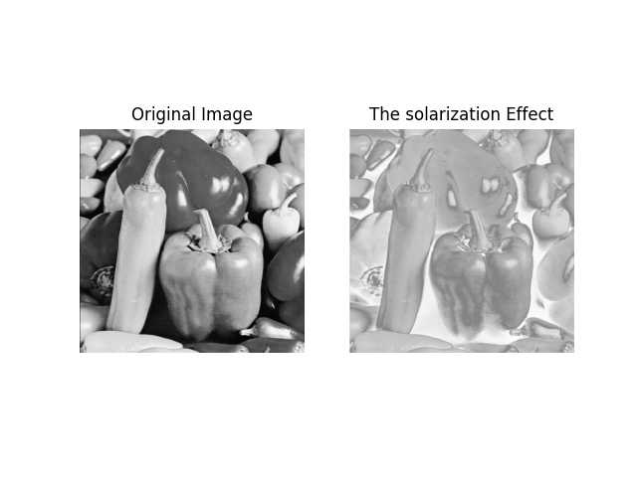
Pixel Effects The solarization effect
Python code:
#The solarization effect
u=fg>0.5
sol=u*fg+(1-u)*(1-fg)
plt.imshow(sol,vmin=0,vmax=1, cmap='gray')
plt.title('The solarization Effect')
Fig: The solarization effect

Slide 10
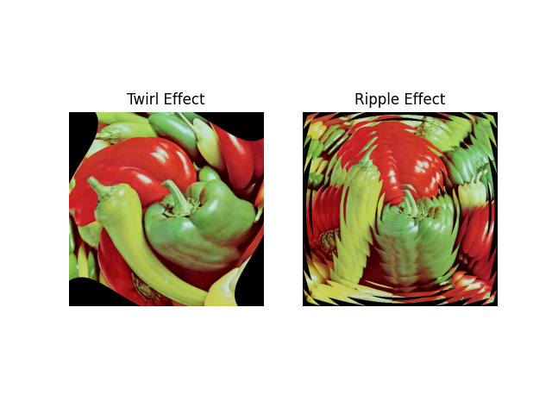
Pixel Effects The color effect
Python code:
#The color effect
r, theta = polarmesh(fg)
k = 250
phi = theta + r / k
r2 = r + (r % 30)
twirl = np.zeros_like(f)
ripple = np.zeros_like(f)
for i in range(3):
twirl[:, :, i] = polar2im(f[:, :, i], r, phi)
ripple[:, :, i] = polar2im(f[:, :, i], r2, theta)
Fig: The COLOR INSERT Effects on a color image

